Slide 1

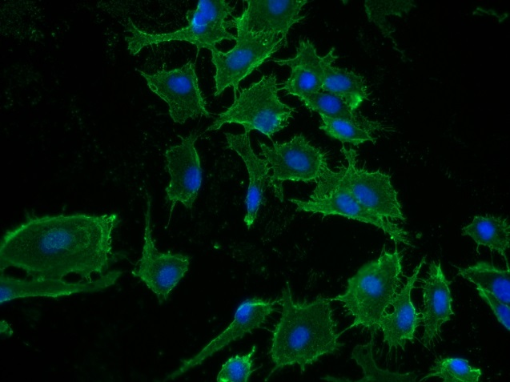
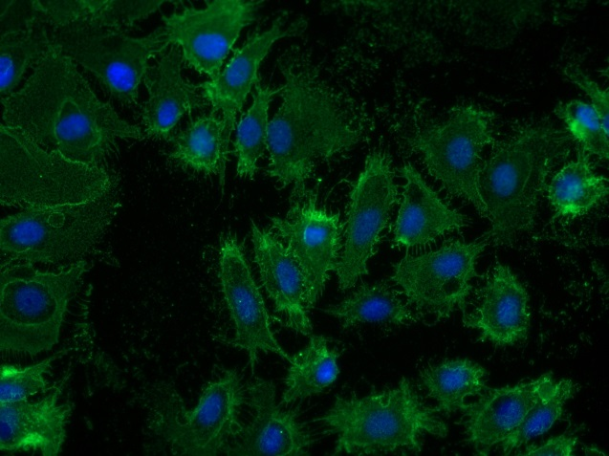
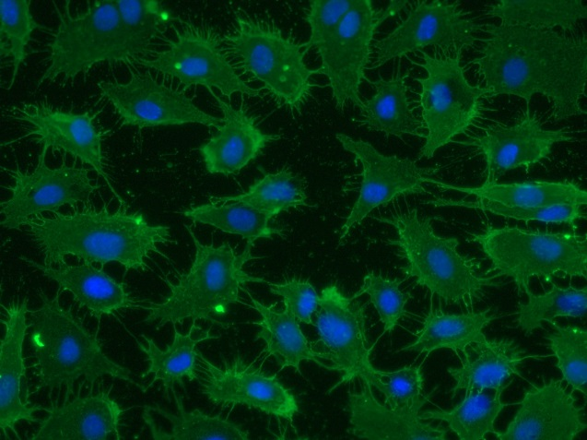
Reliatech GmbH
Mouse anti-human Podoplanin
(Cat# 101-M41)
1µg/ml
5µg/ml
10µg/ml
Immunofluorescence staining of human Podoplanin in primary human lymphatic endothelial cells (HDLEC) using a monoclonal mouse anti-human Podoplanin (#101-M41) antibody.
As secondary antibody goat anti-mouse ALEXA Flour 488 (Dianova) was used 1:400. [IF_LEC1401-02]
.
http://www.reliatech.de / orders@reliatech.de

